Slide 1
DUMBWAYS FINAL TASK
I Gusti Bagus Dharma Putra

Slide 2
Agenda
01
02
03
04
05
Repository
Server
User
SSH
Database
06
07
08
09
10
Web Server
Deployment
CI/CD
Monitoring
AUTH

Slide 3
01 Repository

Slide 4
Repository
01
DUPLICATE
02
ADD NEW BRANCH
CLONE AND MAKE IT PRIVATE
ADD DEPLOYMENT AND PRODUCTION

Slide 5
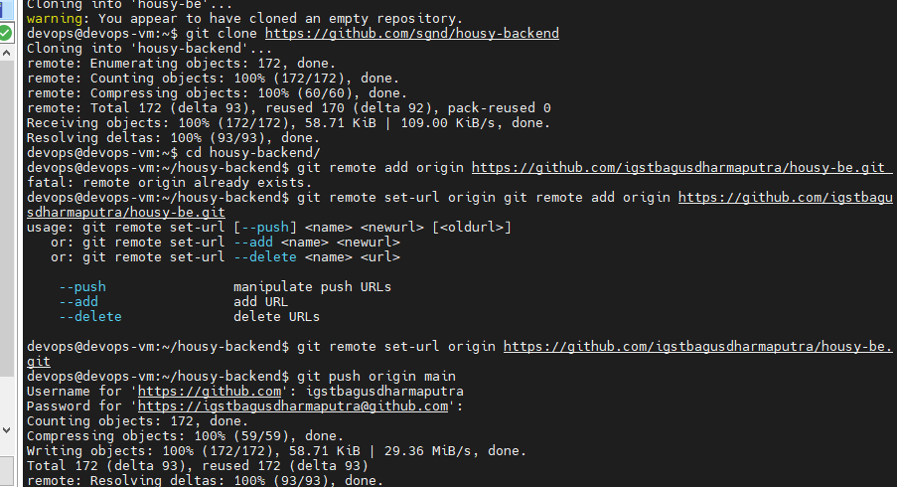
Repository
Clone Repository

Slide 6
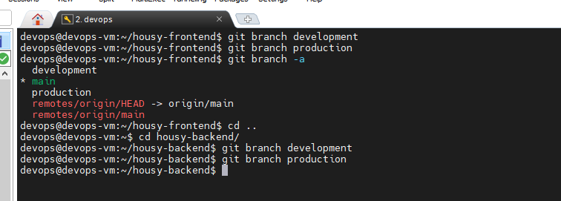
Repository
Create Branch

Slide 7
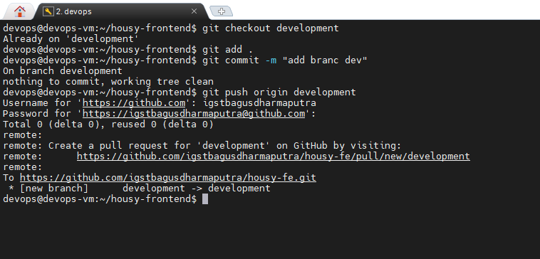
Repository
Git push dev

Slide 8
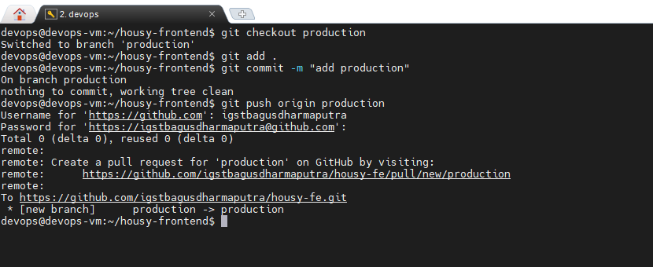
Repository
Git push production

Slide 9
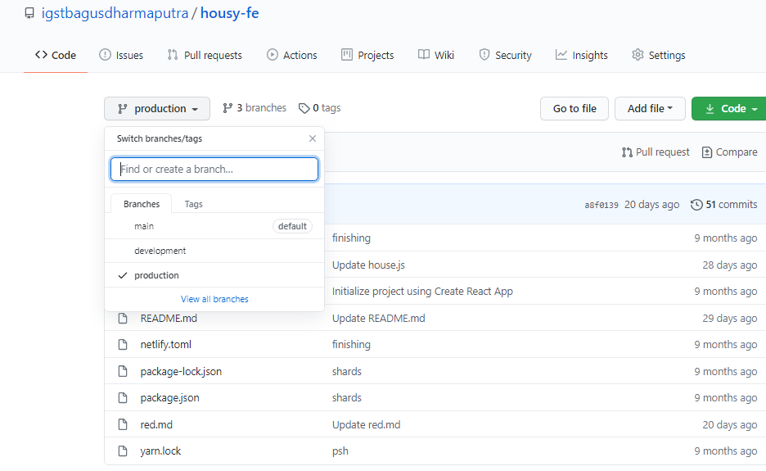
Repository
Repository

Slide 10
02 Server

Slide 11
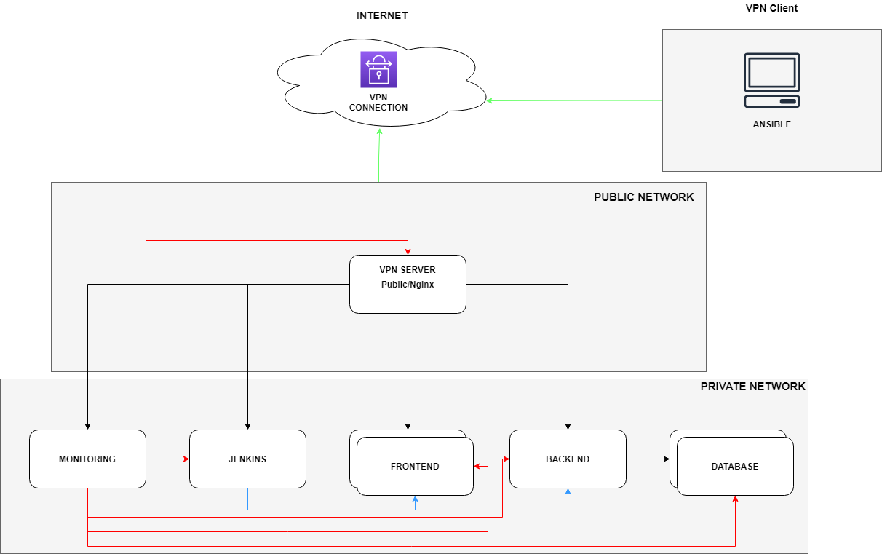

Slide 12
NAT INSTANCE
1
CREATE PUBLIC AND PRIVATE SUBNET
2
CREATE VPC NAT HVM
VPC
3
ADD ROUTE TABLE
4
IMPLEMENT

Slide 13
Server
SERVER PUBLIC
Bisa diakses oleh siapa saja dan akan terisi web server NGINX untuk Reverse-Proxy
PUBLIC
SERVER WITH ELASTIC IP
NAT
INSTANCE WITH INTERNET GATEWAY
PRIVATE
CONNECT TO NAT INSTANCE
SERVER PRIVATE
Terbatas hanya bisa diakses oleh server public dengan security yang berbeda - beda

Slide 14
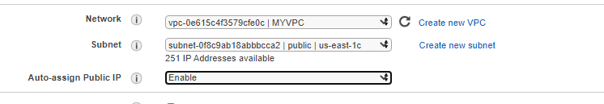
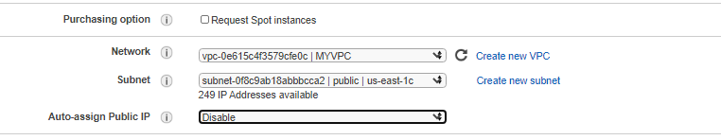
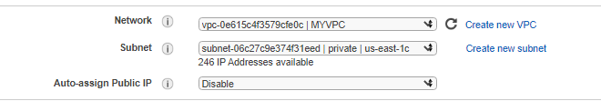
NAT INSTANCE
PUBLIC SERVER
PRIVATE SERVER

Slide 15
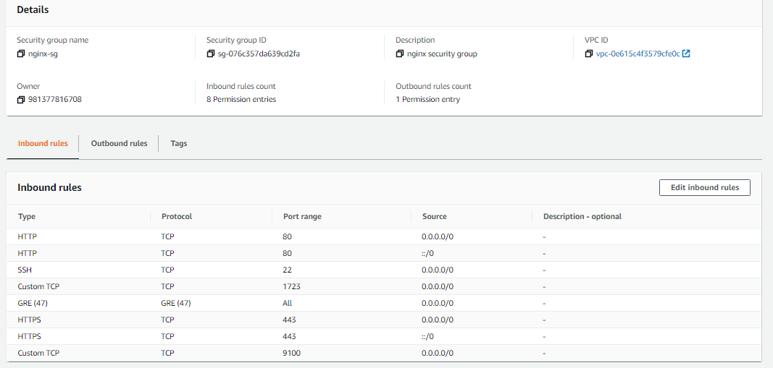
Server Security Group
Nginx

Slide 16
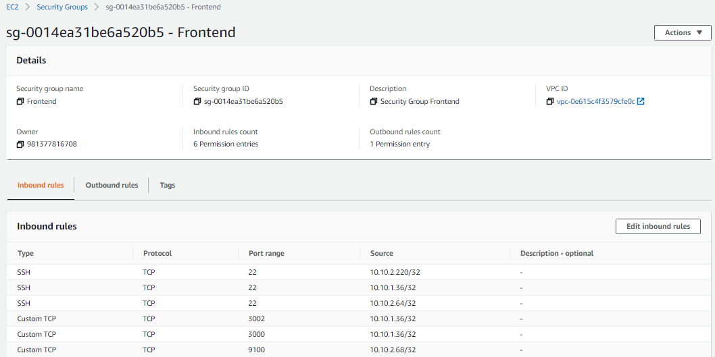
Server Security Group
Frontend

Slide 17
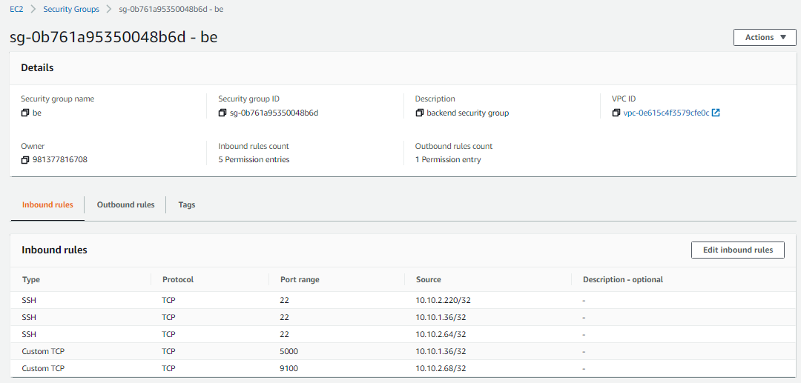
Server Security Group
Backend

Slide 18
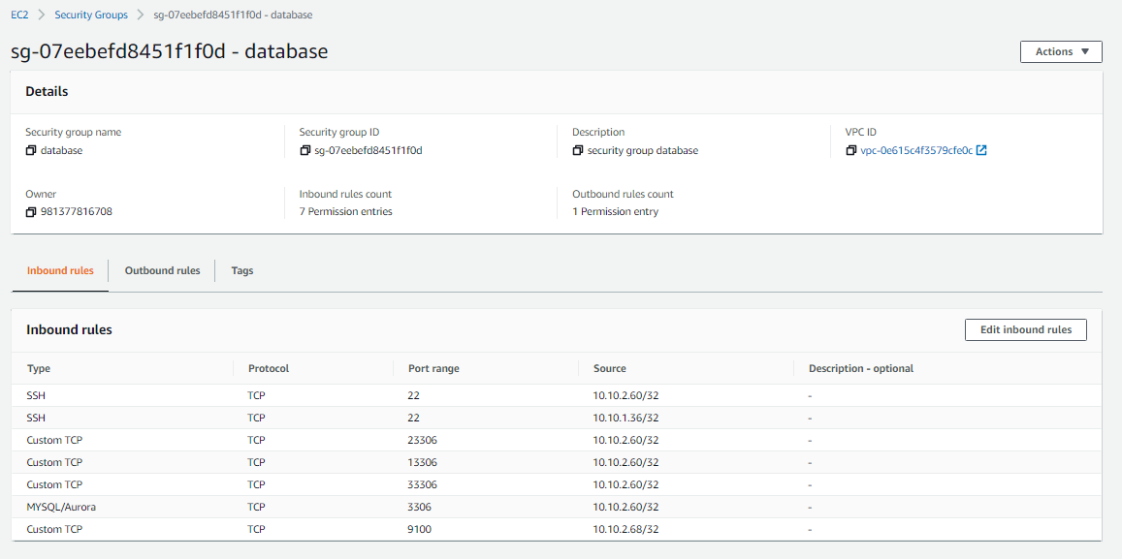
Server Security Group
Database

Slide 19
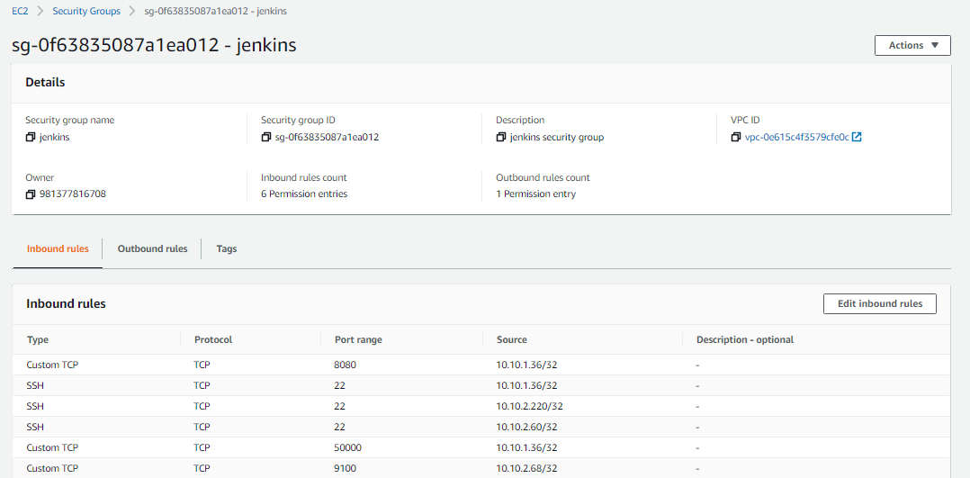
Server Security Group
Jenkins

Slide 20
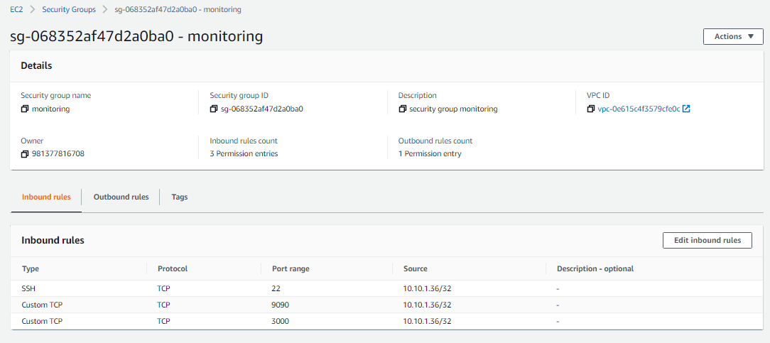
Server Security Group
Monitoring

Slide 21
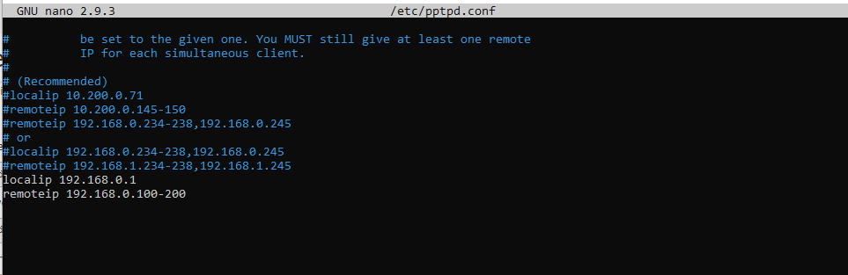
Setup VPN
Setup PPTPD

Slide 22
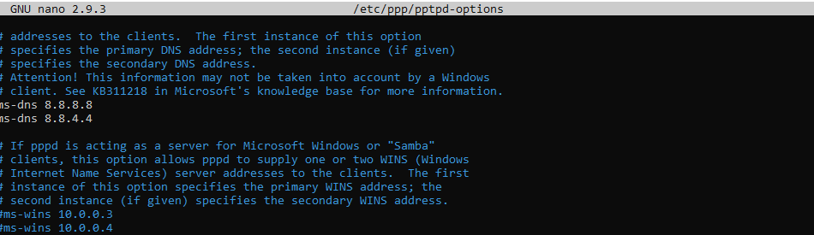
Setup VPN
Setup PPTPD

Slide 23
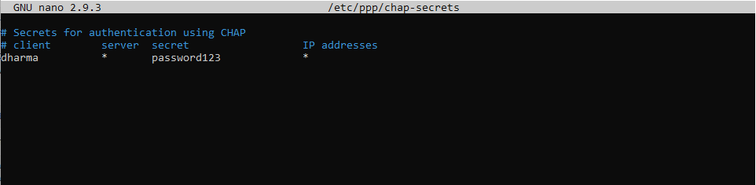
Setup VPN
Setup PPTPD

Slide 24
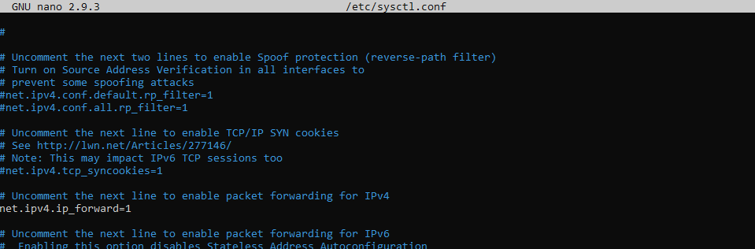
Setup VPN
Setup iptable

Slide 25
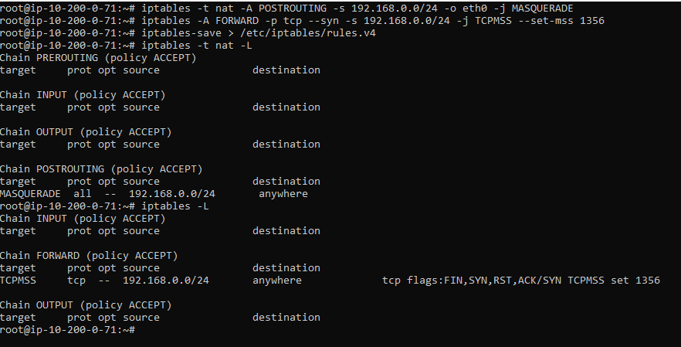
Setup VPN
Setup iptable

Slide 26
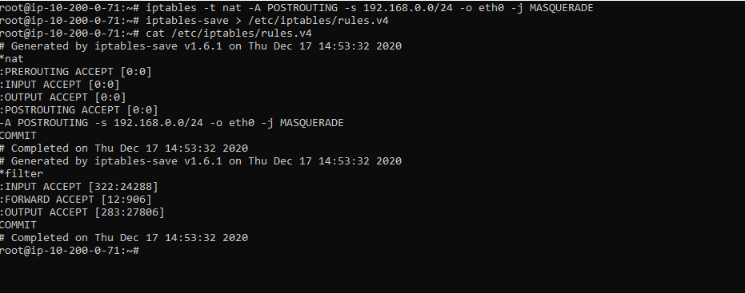
Setup VPN
Setup iptable

Slide 27
03 User

Slide 28
User
Mempersiapkan kebutuhan sebelum membuat user ke semua server agar lebih cepat
INSTALL DOCKER TO EVERY SERVER
UPDATE
& UPGRADE
ADD INVENTORY & CREATE USER
EDIT ROOT AUTHORIZED
INSTALL
ANSIBLE

Slide 29
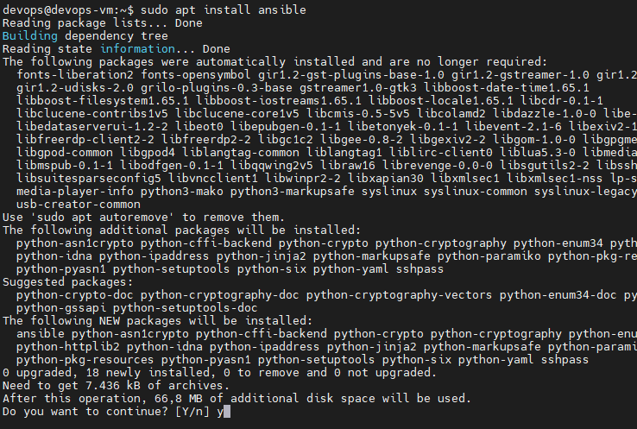
User
Install ansible

Slide 30
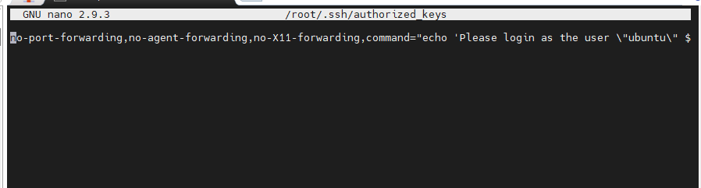
User
Edit root authorized

Slide 31
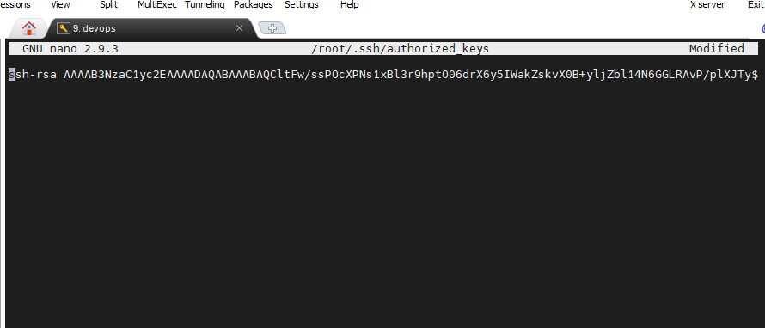
User
Edit root authorized

Slide 32
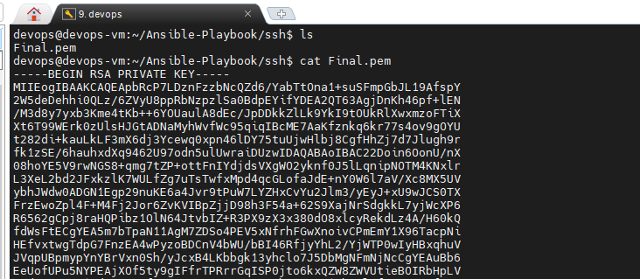
User
SSH Key Aws

Slide 33
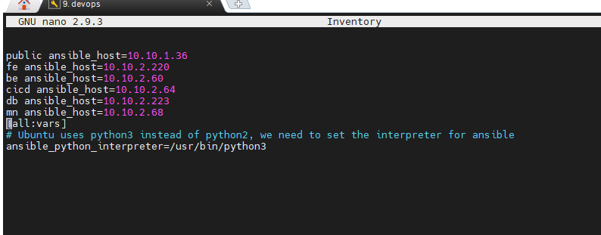
User
Inventory

Slide 34
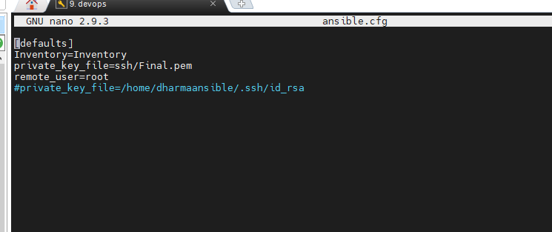
User
Ansible.cfg

Slide 35
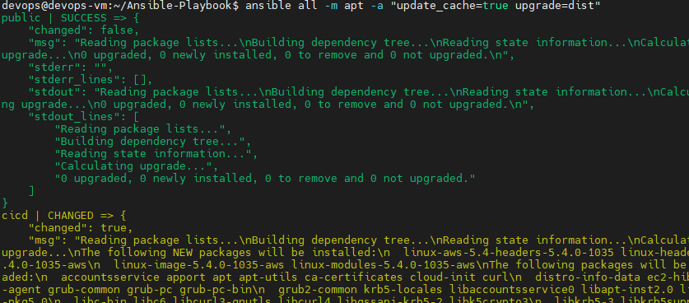
User
Update and Upgrade using ansible

Slide 36
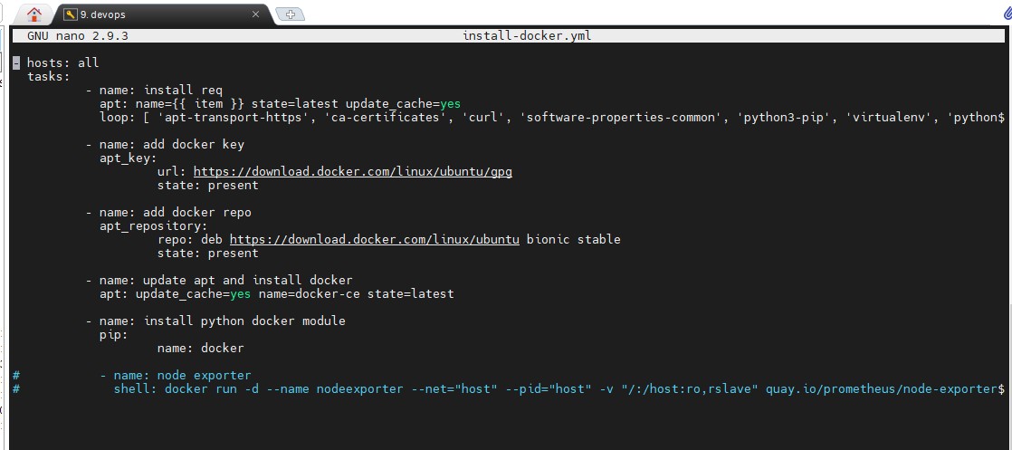
User
Install Docker Using Anisble

Slide 37
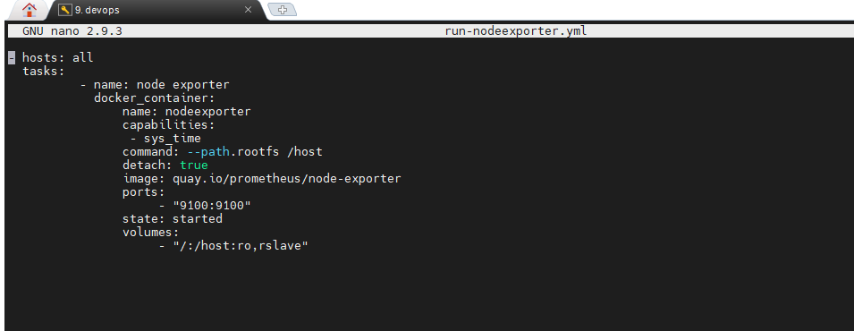
User
Install Nodexporter Using Anisble

Slide 38
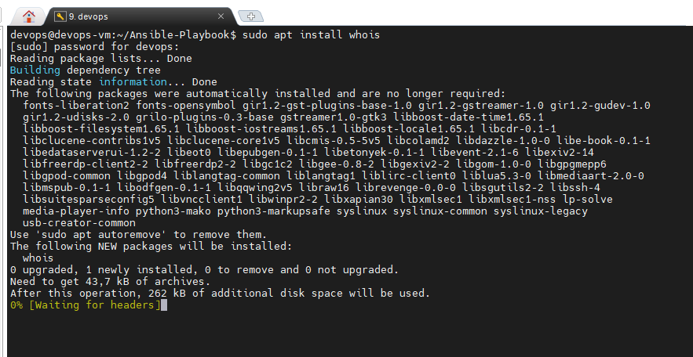
User
Install whois

Slide 39
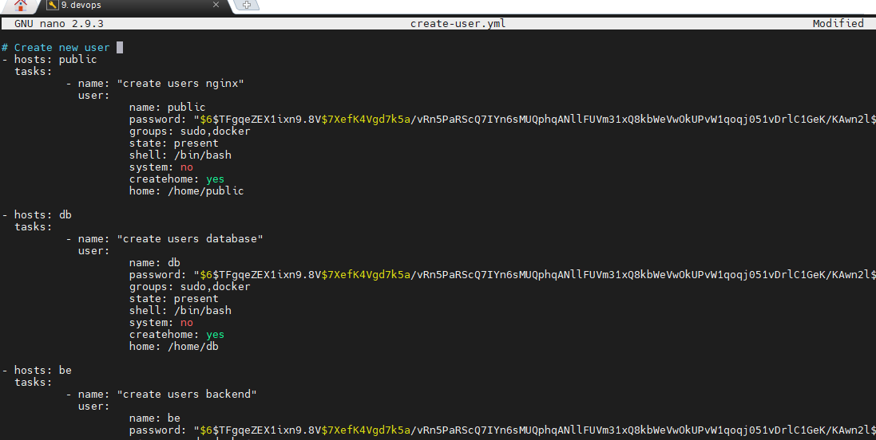
User
Create User

Slide 40
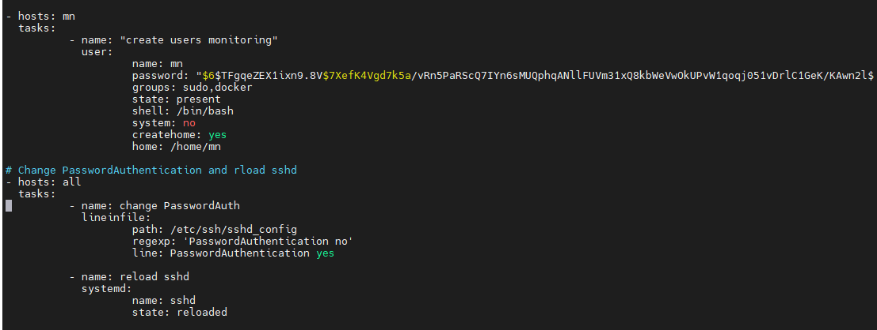
User
Create User edit sshd_config

Slide 41
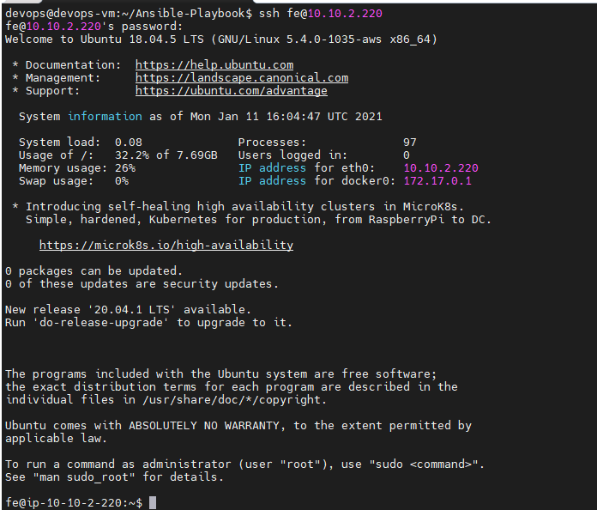
User
User Login

Slide 42
04 SSH

Slide 43
SSH
Generate SSH
Generate SSH dengan ansible
Create User Universal
Membuat user global untuk akses server dengan ip atau hostname dan login tanpa username atau password

Slide 44
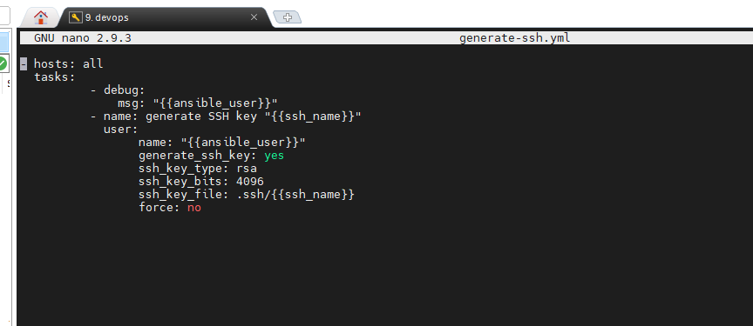
SSH
Generate ssh with ansiable

Slide 45
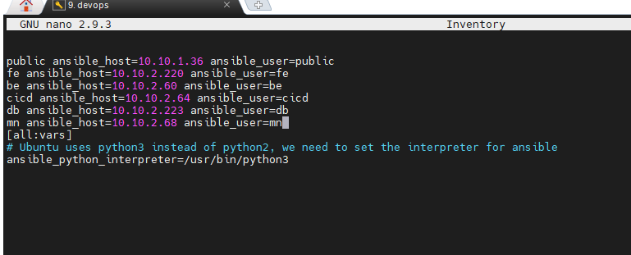
SSH
Inventory

Slide 46
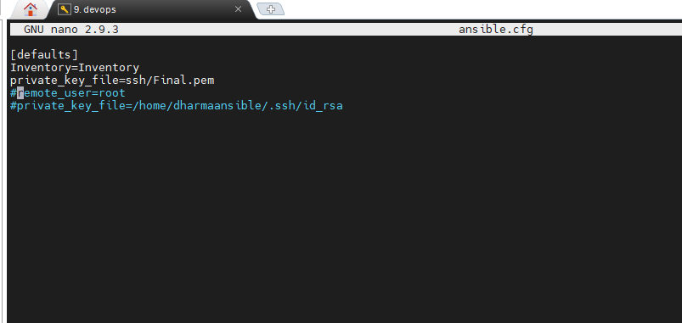
SSH
Ansible.cfg

Slide 47
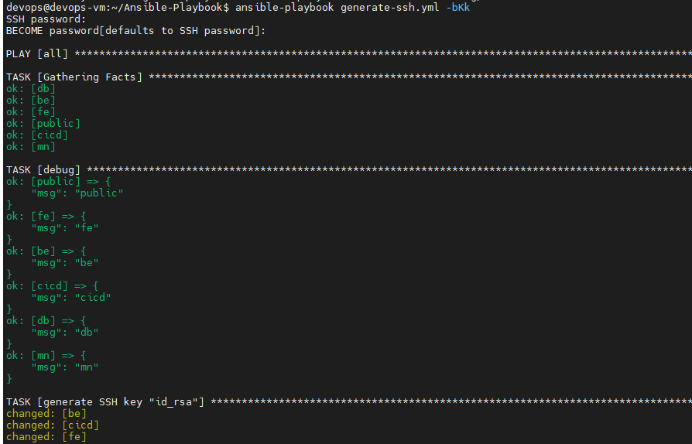
SSH
Proses generate

Slide 48
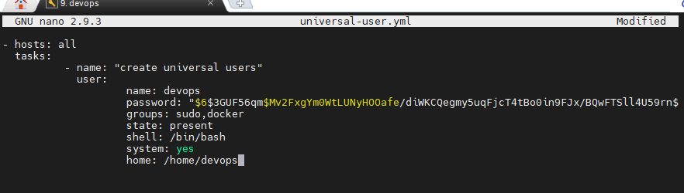
SSH
Universal User

Slide 49
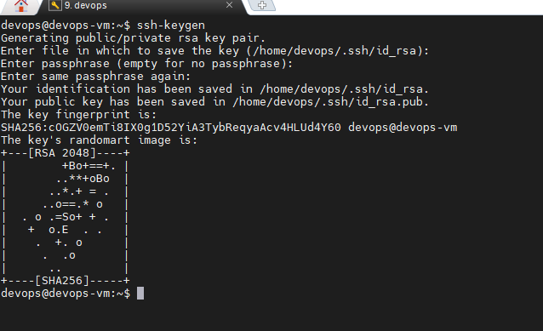
SSH
Ssh-copy-id <ip address>
SSH keygen on Ansible

Slide 50
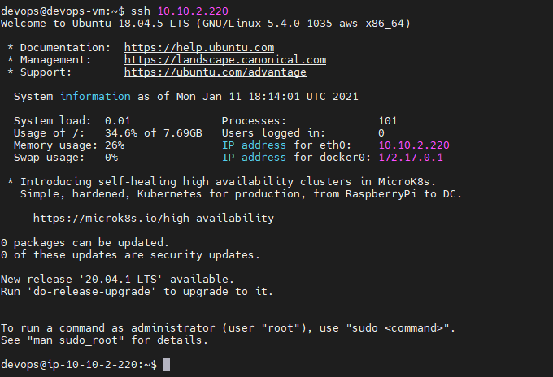
SSH
Testing Login

Slide 51
05 Database

Slide 52
Database
DATABASE
Database Cluster dengan Docker
Load Balancing
Backup link traffic ketika node down
MariaDB
Cek Database

Slide 53
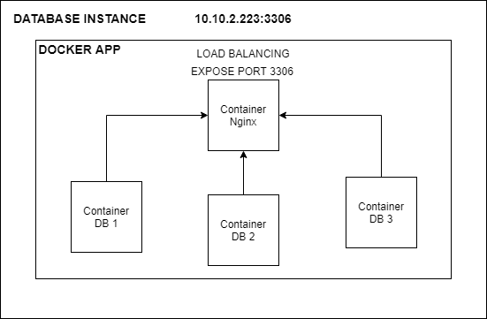
Database
schematic

Slide 54
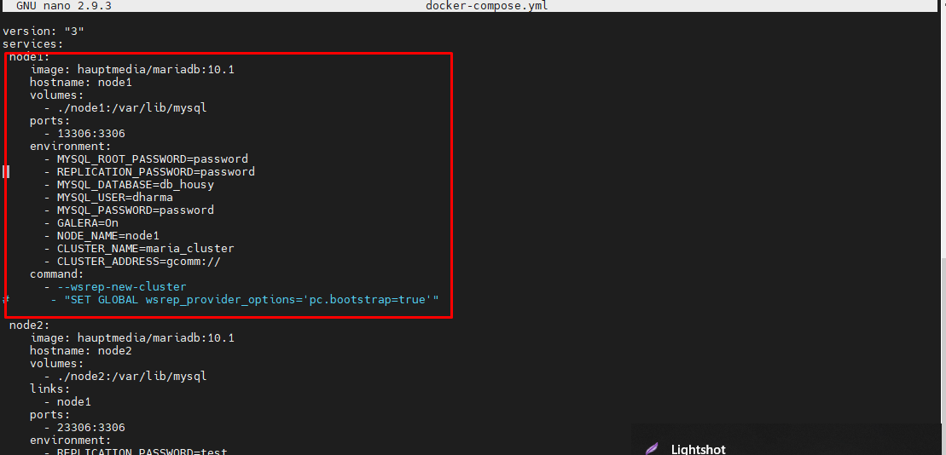
Database
Set up cluster with galera using docker

Slide 55
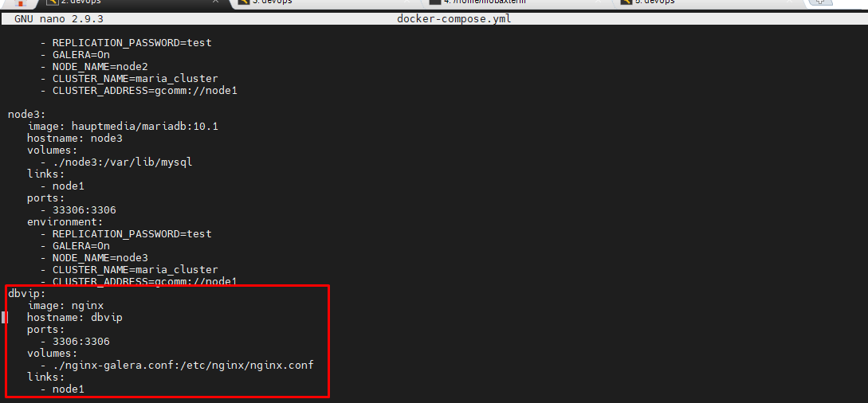
Database
Load balancing using docker

Slide 56
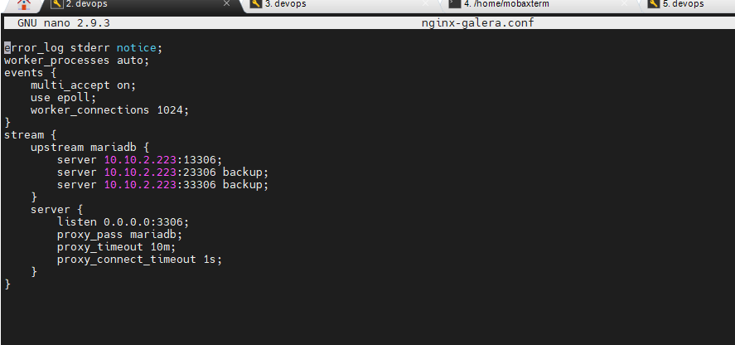
Database
Load balancing virtualhost

Slide 57
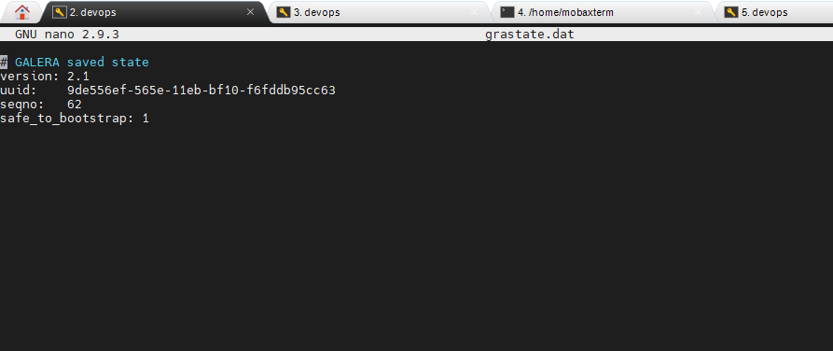
Database
Set safe to boostrap

Slide 58
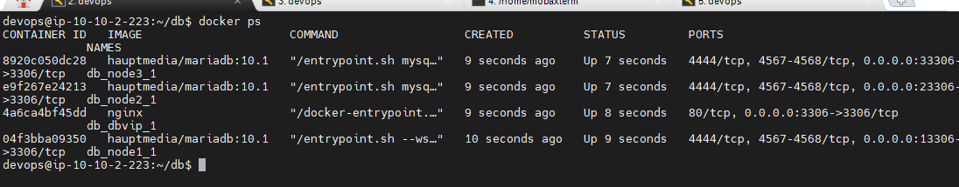
Database
Service running

Slide 59
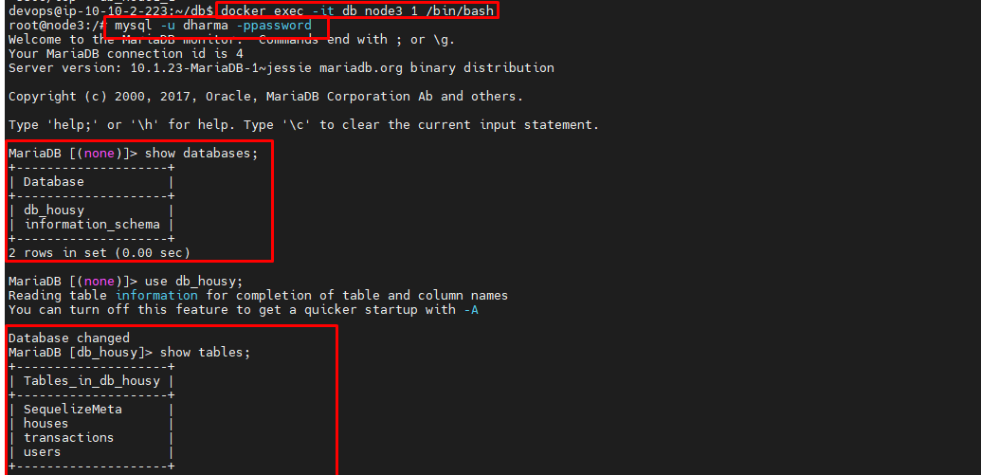
Database
Connect Database from container

Slide 60
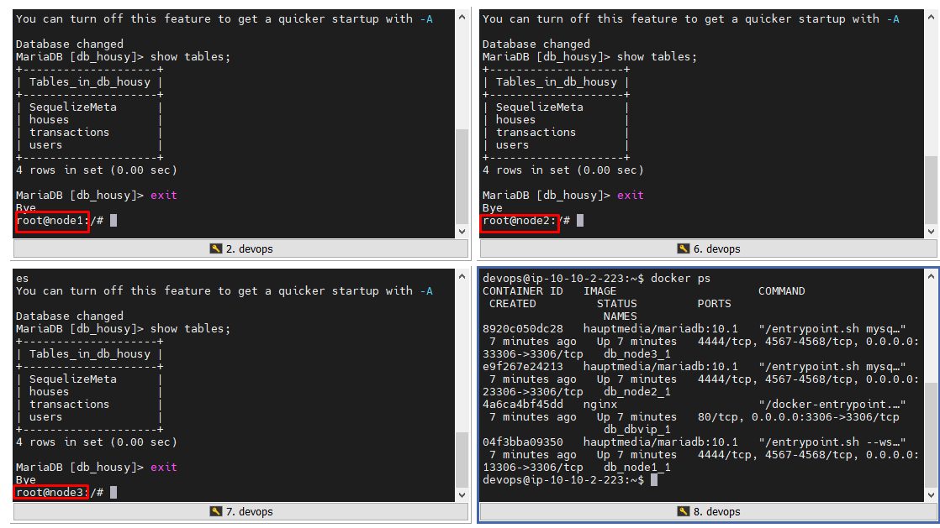
Database
Check Database

Slide 61
06 Web Server

Slide 62
Web Server
INSTALL
Install Nginx dengan bantuan ansible
CREATE
Buat konfigurasi untuk reverse proxy
COPY
Copy konfigurasi ke server public(nginx)
SSL
tambahkan ssl dengan let’s encrypt

Slide 63
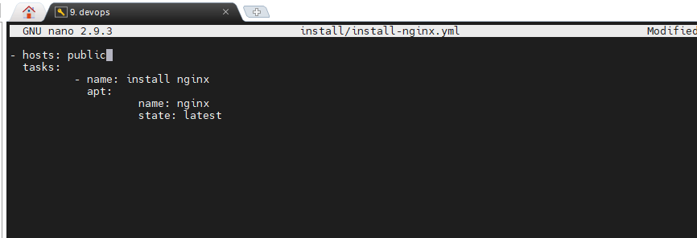
Web Server
Install nginx with ansible

Slide 64

Web Server
Copy config virtual host to nginx server

Slide 65

Web Server
SSL Config with Ansible

Slide 66

Web Server
SSL Config with Ansible

Slide 67

Web Server
SSL Config with Ansible

Slide 68

Web Server
Test Access Web using https

Slide 69

Web Server
Generate SSL VirtualHost

Slide 70
07 Deployment

Slide 71
Deployment
Migrate
Config
Migrate databse melalui container
Edit configurasi config.json
Docker
Run Application
Build dengan docker
Running app menggunakan docker-compose

Slide 72

Deployment
Git clone app

Slide 73

Deployment
Dockerfile Frontend

Slide 74

Deployment
Docker-compose frontend

Slide 75

Deployment
Build Image

Slide 76

Deployment
Run app frontend

Slide 77

Deployment
Dockerfile Backend

Slide 78

Deployment
Docker-compose backend

Slide 79

Deployment
Build Image Backend

Slide 80

Deployment
Running app backend

Slide 81

Deployment
Virtual Host Frontend

Slide 82

Deployment
Virtual Host Backend

Slide 83

Deployment
Virtual Host Jenkins

Slide 84

Deployment
Virtual Host Monitoring

Slide 85

Deployment
Web Housy

Slide 86

Deployment
Api Housy

Slide 87

Deployment
Edit api on frontend

Slide 88

Deployment
Edit file config.json

Slide 89

Deployment
Migrate Database from container backend

Slide 90

Deployment
Check Databases

Slide 91

Deployment
Show tables

Slide 92

Deployment
Generate User from postman API

Slide 93
08 CI/CD

Slide 94

CI/CD
schematic

Slide 95
CI/CD CREDENTIALS
1
3
ADD SSH KEY SERVER
CONFIG GITHUB SERVER
Menambahkan ssh key private ke jenkins untuk diakses Publish over ssh
Menghubungkan jenkins dengan github server
CI/CD
ADD PERSONAL TOKEN GITHUB
ADD NOTIFICATION
Masukan slack notification ke post-build untuk notifikasi
Ambil personal token github untuk push trigger
2
4

Slide 96

CI/CD
Install Jenkins with ansible

Slide 97

CI/CD CREDENTIALS
SSH Key Untuk Publish Over SSH

Slide 98

CI/CD CREDENTIALS
Personal Access Token

Slide 99

CI/CD CREDENTIALS
Github Token

Slide 100

CI/CD CREDENTIALS
Jenkins Connect to Github

Slide 101

CI/CD CREDENTIALS
Credential ssh private key

Slide 102

CI/CD CREDENTIALS
Slack Token

Slide 103

CI/CD CREDENTIALS
Jenkins connect to slack

Slide 104

CI/CD CREDENTIALS
Credential

Slide 105

CI/CD
Freestyle Project Jenkins

Slide 106

CI/CD
Freestyle Project Jenkins

Slide 107

CI/CD
Freestyle Project Jenkins

Slide 108

CI/CD
Post Build Jenkins

Slide 109

CI/CD
Result from slack notification

Slide 110

CI/CD
Succesful process job jenkins

Slide 111
09 Monitoring

Slide 112
Monitoring
PROM/PROMETHEUS
GRAFANA
Install prometheus menggunakan docker dengan membuka port 9090 dan menambahkan volume
Install grafana menggunakan docker dan buka port 3000
PROMETHEUS
GRAFANA
CONFIG
RUN
CONNECT
prometheus.yml
RUN PROM
DASHBOARD
Buat konfigurasi Prometheus yang mencakup seluruh server dengan port 9100
Jalankan prometheus menggunakan docker run dan pastikan sudah ada pada docker ps
Hubungkan prometheus dengan grafana dan percantik dashboard agar lebih mudah mendapat informasi server

Slide 113

Monitoring
prometheus.yml

Slide 114

Monitoring
prometheus config with ansible

Slide 115

Monitoring
Grafana config with ansible

Slide 116

Monitoring
[users]
# disable user signup / registration
allow_sign_up = false
[auth.anonymous]
# enable anonymous access
enabled = false
Grafana.ini

Slide 117
Monitoring
node_filesystem_free_bytes (storage)
node_memory_MemAvailable_bytes (memory)
node_cpu_seconds_total (cpu)
node_network_receive_bytes_total (network receive)
node_network_transmit_bytes_total (network transmit)
Parameter from prometheus

Slide 118
Monitoring
STORAGE
100*(1-(node_filesystem_free_bytes{device="/dev/xvda1", fstype="ext4",job="node_exporter", mountpoint="/"} / node_filesystem_size_bytes{device="/dev/xvda1", fstype="ext4", job="node_exporter", mountpoint="/"}))
MEMORY
(1 - (node_memory_MemAvailable_bytes{job=~"node_exporter"} / (node_memory_MemTotal_bytes{job=~"node_exporter"})))* 100
CPU
100 - (avg by (instance) (irate(node_cpu_seconds_total{job="node_exporter",mode="idle"}[5m])) * 100)
NETWORK RECEIVE
irate(node_network_receive_bytes_total{job="node_exporter"}[5m])*8 or irate(node_network_receive_bytes{job="node_exporter"}[5m])*8
NNETWORK TRANSAMIT
irate(node_network_transmit_bytes_total{job="node_exporter"}[5m])*8 or irate(node_network_transmit_bytes{job="node_exporter"}[5m])*8
Data from prometheus to grafana

Slide 119

Monitoring
Data from grafana

Slide 120

Monitoring
Import template dashboard

Slide 121

Monitoring
Import template dashboard

Slide 122

Monitoring
https://grafana.com/grafana/dashboards/11074

Slide 123
10 AUTH

Slide 124
AUTH
htpasswd
auth_basic
apache2-utils
user_file

Slide 125

AUTH
sudo htpasswd -c /etc/nginx/.htpasswd admin
Virtual Host Monitoring

Slide 126

AUTH
Pengujian

Slide 127

AUTH
Halaman Prometheus

Slide 128
DEMO

Slide 129
TERIMA KASIH

